Slide 1



Slide 2
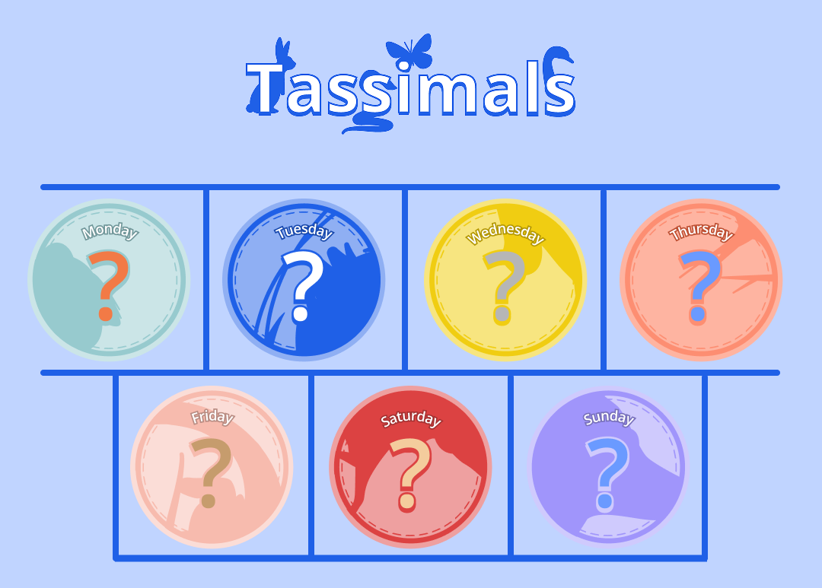
The Days Of The Week Competition Reveal

Slide 3








Our new collection
…with £500 in prizes to be won!

Slide 4
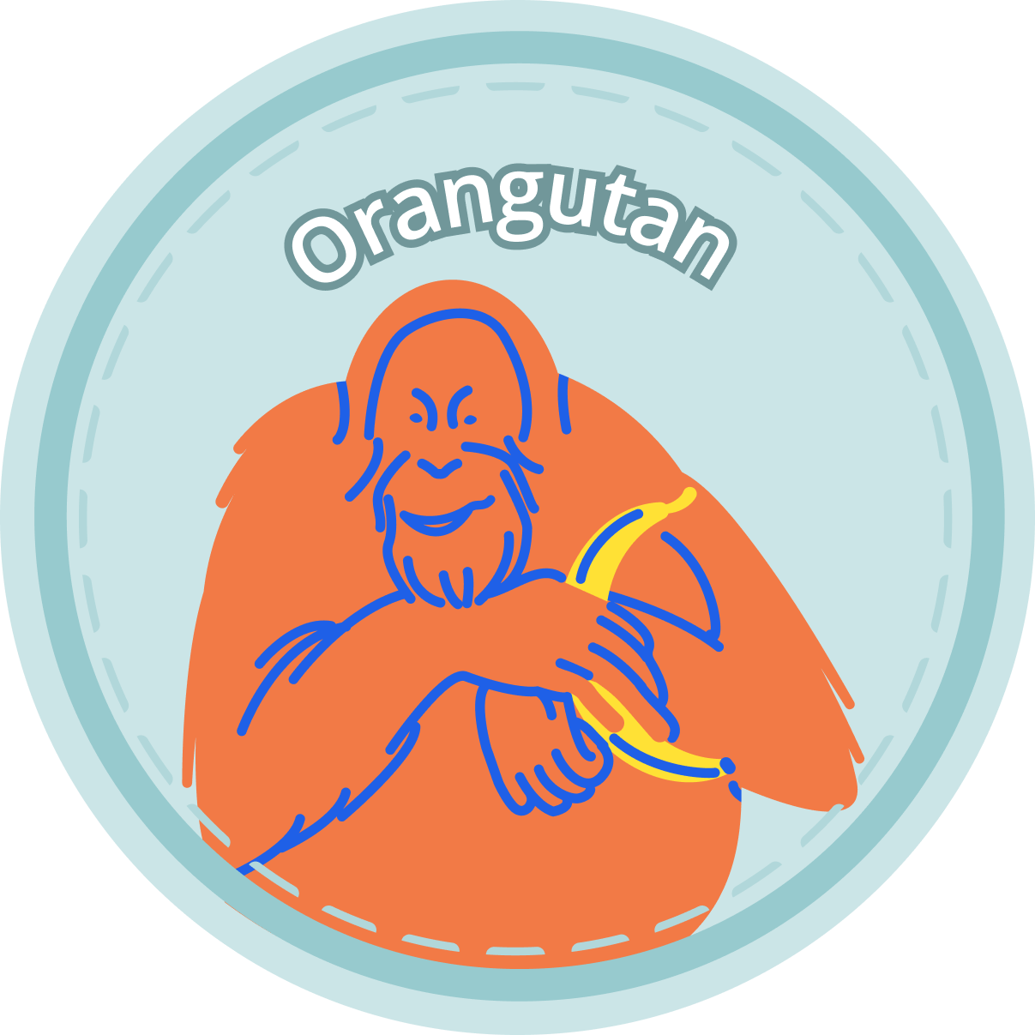
The competition…
The first task was to collect all seven stickers.
THOUSANDS of you achieved that goal by spreading your practice throughout the week - well done!

Slide 5
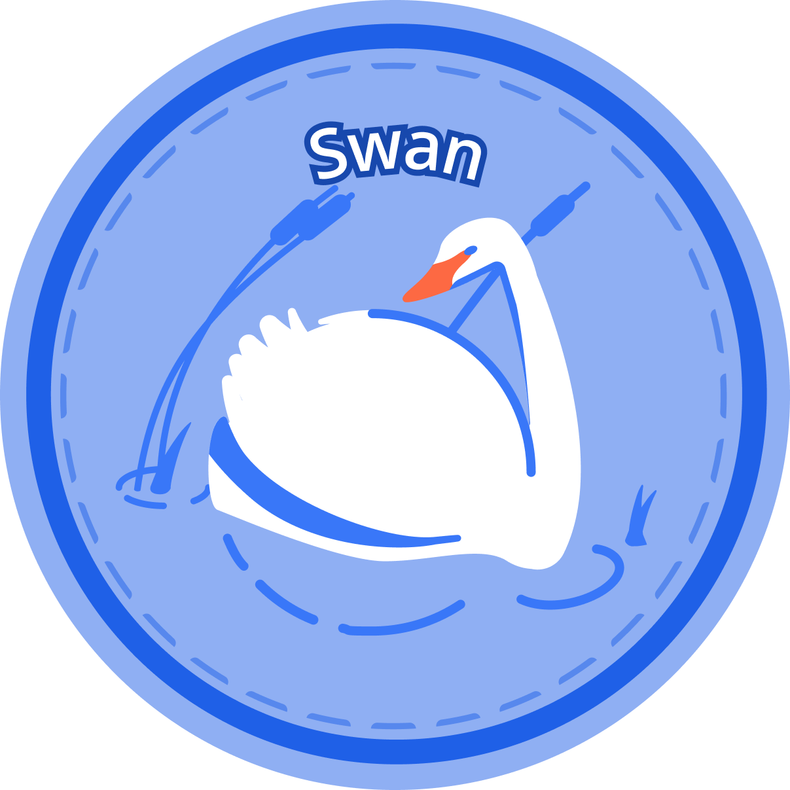
The competition…
The second task was to look at each animal and work out what link connected it to its day of the week;
We had hundreds of brilliant guesses, but there was only one solution…

Slide 6
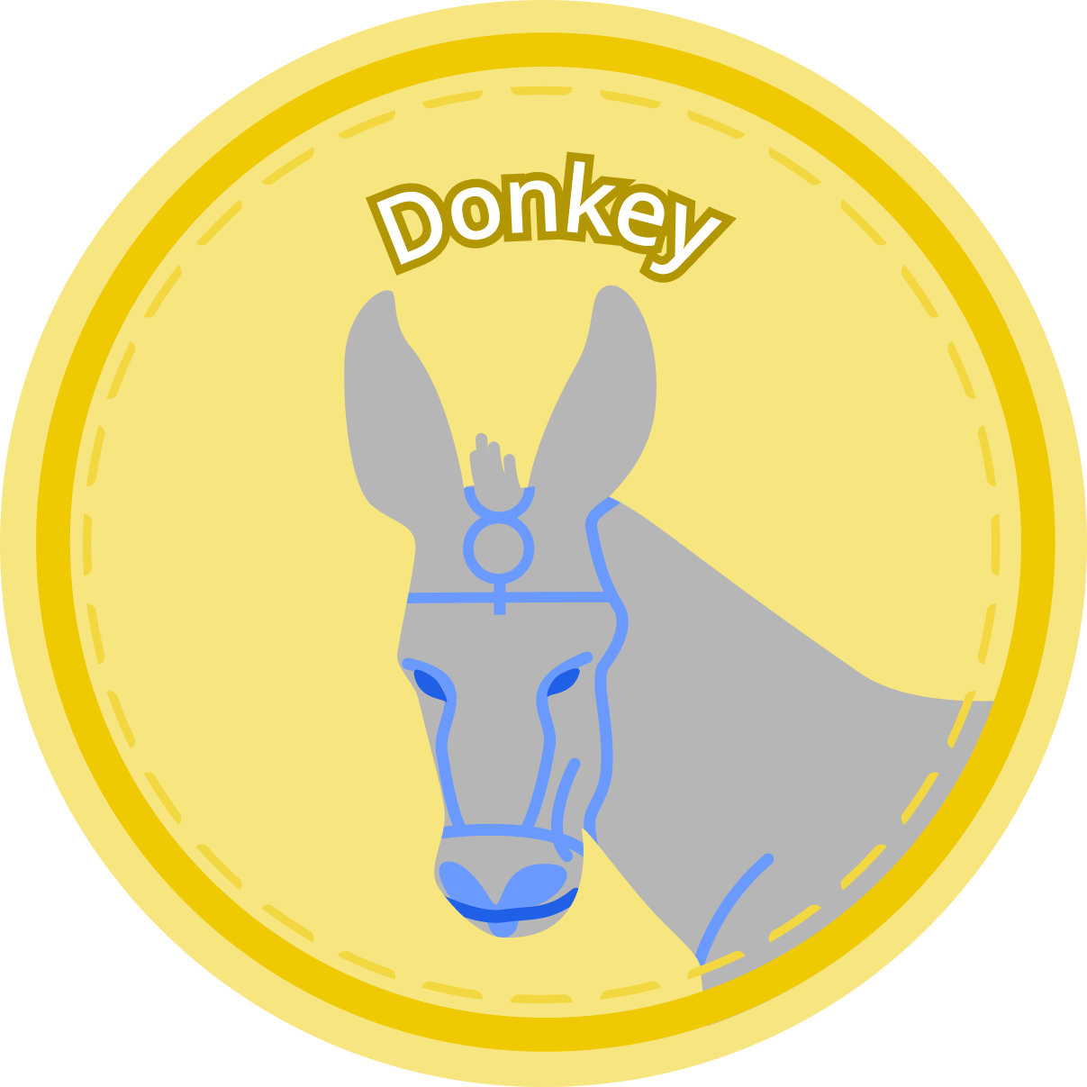
The competition…
There were extra clues in the text behind each sticker if you clicked on it:
Monday - the orangutan - is described as having a beautiful face;
Tuesday - the swan - is graceful;
Wednesday’s Tassimal, the donkey, is commonly used to represent sadness or “woe”…

Slide 7
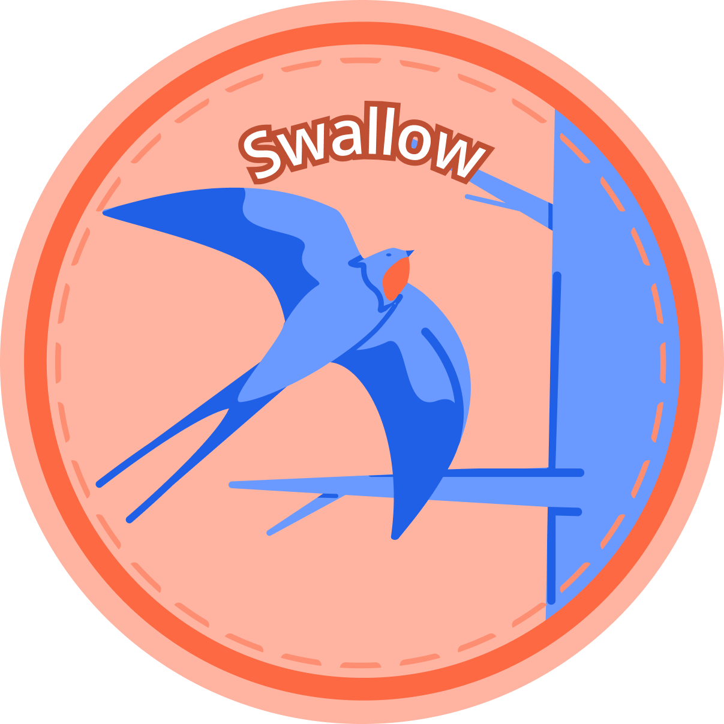
The competition…
Thursday’s (Tassimal) has far to go…

Slide 8
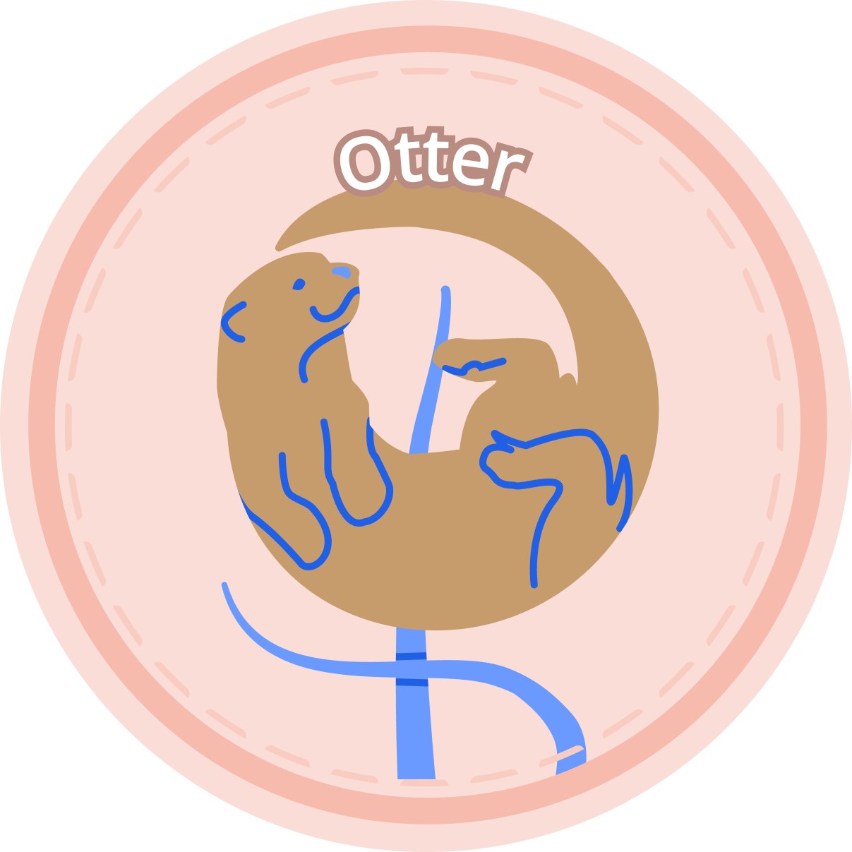
The competition…
The otter is loving and giving, like Friday’s Child

Slide 9
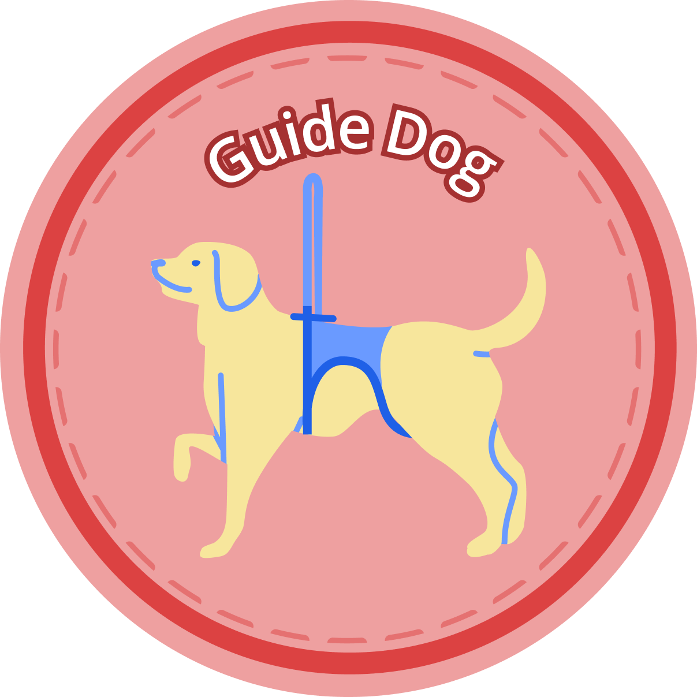
The competition…
Guide Dogs “work hard for a living”

Slide 10
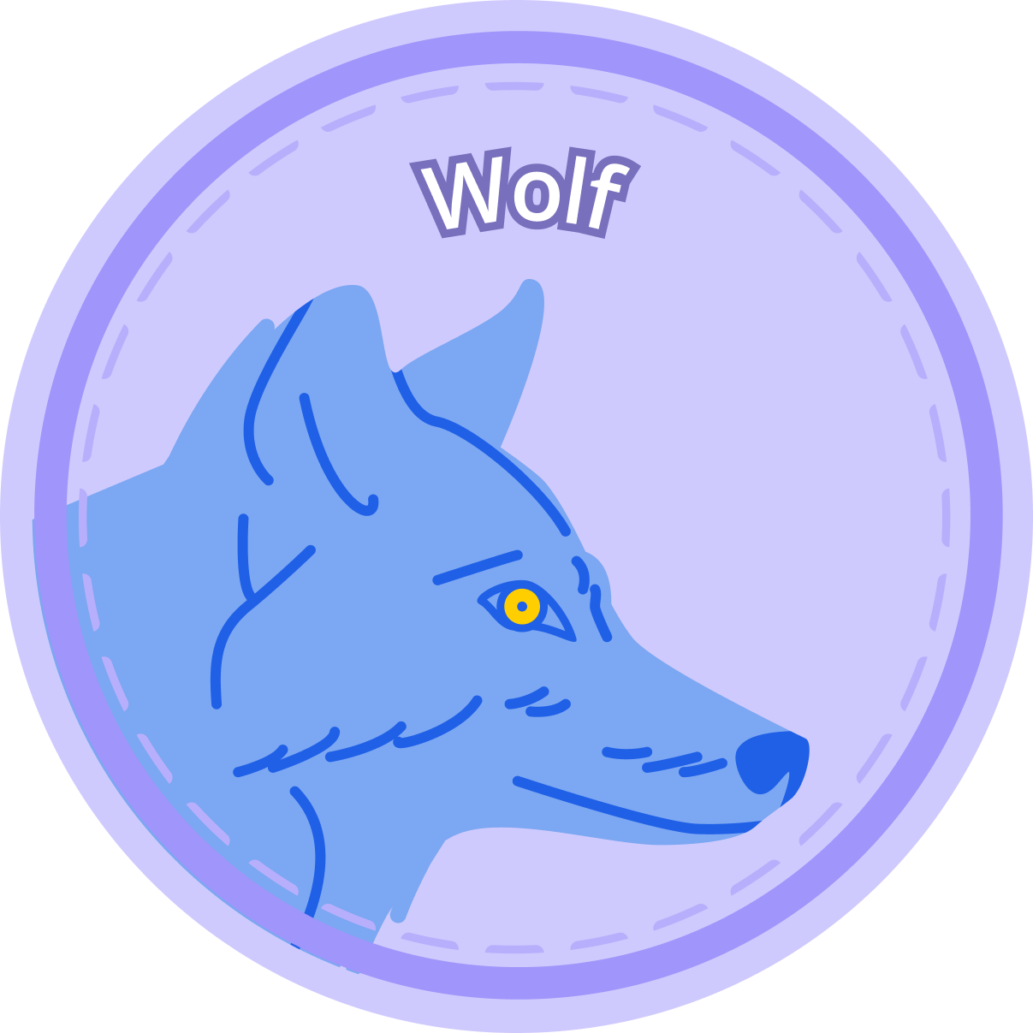
The competition…
And the “Tassimal” born on the sabbath day, is fair and wise - the wolf.
Each of our tassimals was chosen to represent the traditional rhyme “Monday’s Child”
Well done to everyone who solved that part of the puzzle.

Slide 11
But there’s more
Each sticker had a hidden design element which made a separate connection to its day of the week

Slide 12
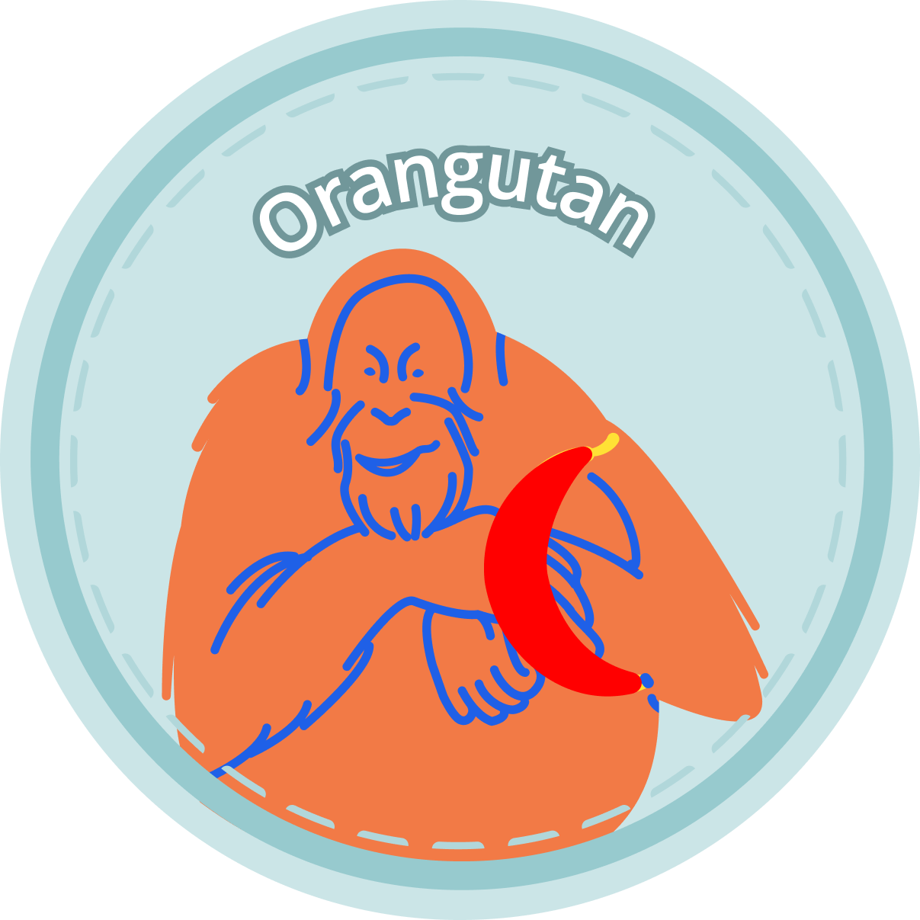
Hidden symbols…
The orangutan’s banana is a familiar shape…
Like the MOON which gives its name to Monday

Slide 13
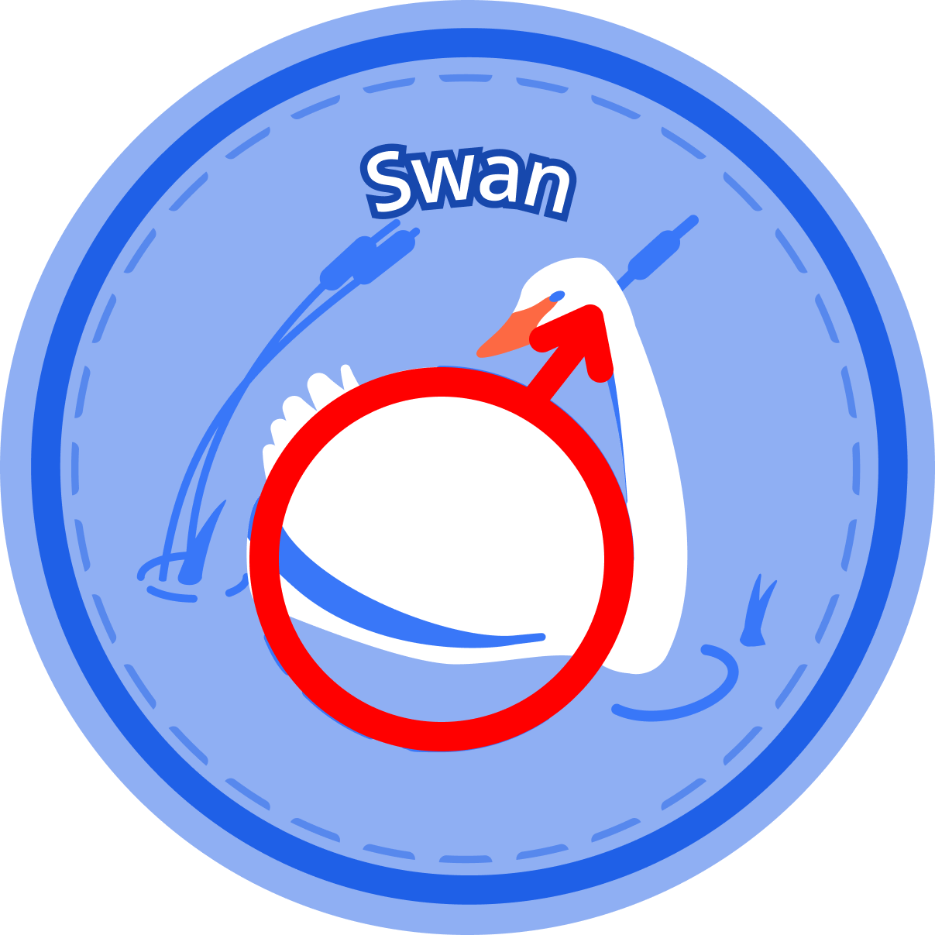
Hidden symbols…
Hidden in the swan picture is the symbol of MARS - the Roman god of war
Mars is also the symbol of Tuesday
In French: mardi

Slide 14
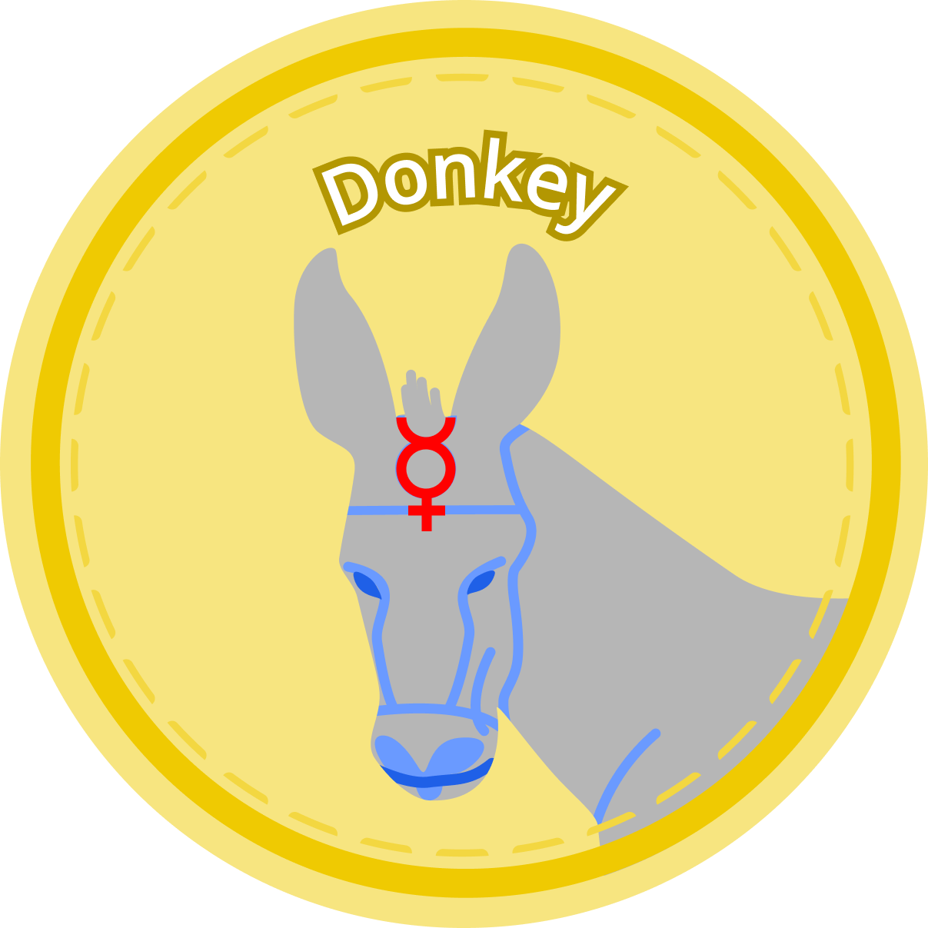
Hidden symbols…
Wednesday (mercredi) is Mercury’s Day
His symbol appears in the donkey’s bridle…

Slide 15
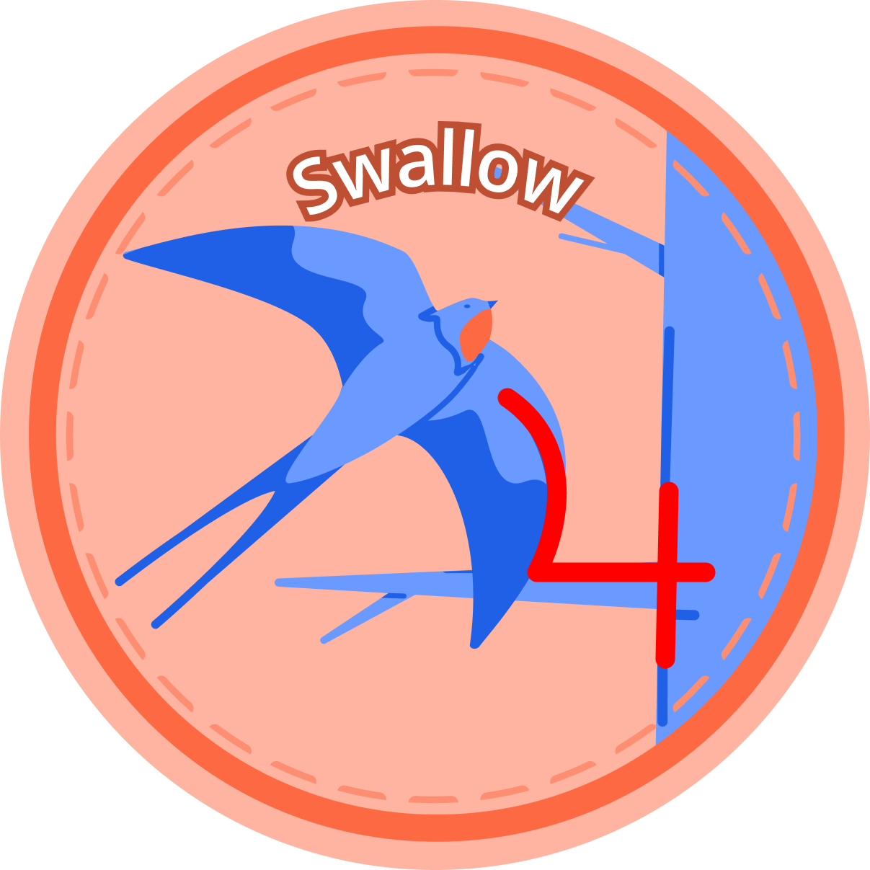
Hidden symbols…
Jupiter’s symbol is formed by the wing and the branch
These symbols have been used in Astronomy for many, many years to represent the ‘classical’ planets.

Slide 16
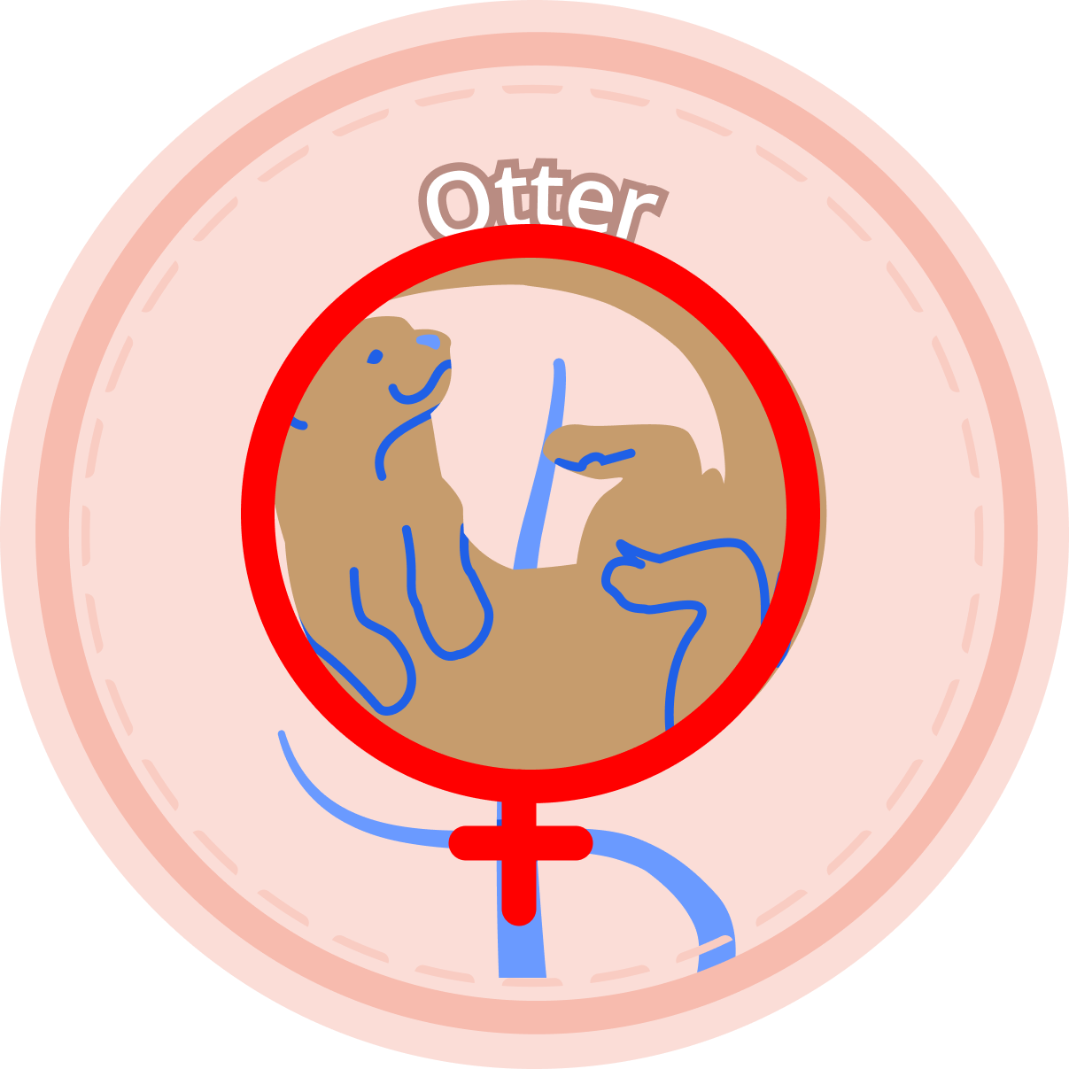
Hidden symbols…
Friday is Venus’ day;
Her symbol is formed by the otter and the reeds.

Slide 17
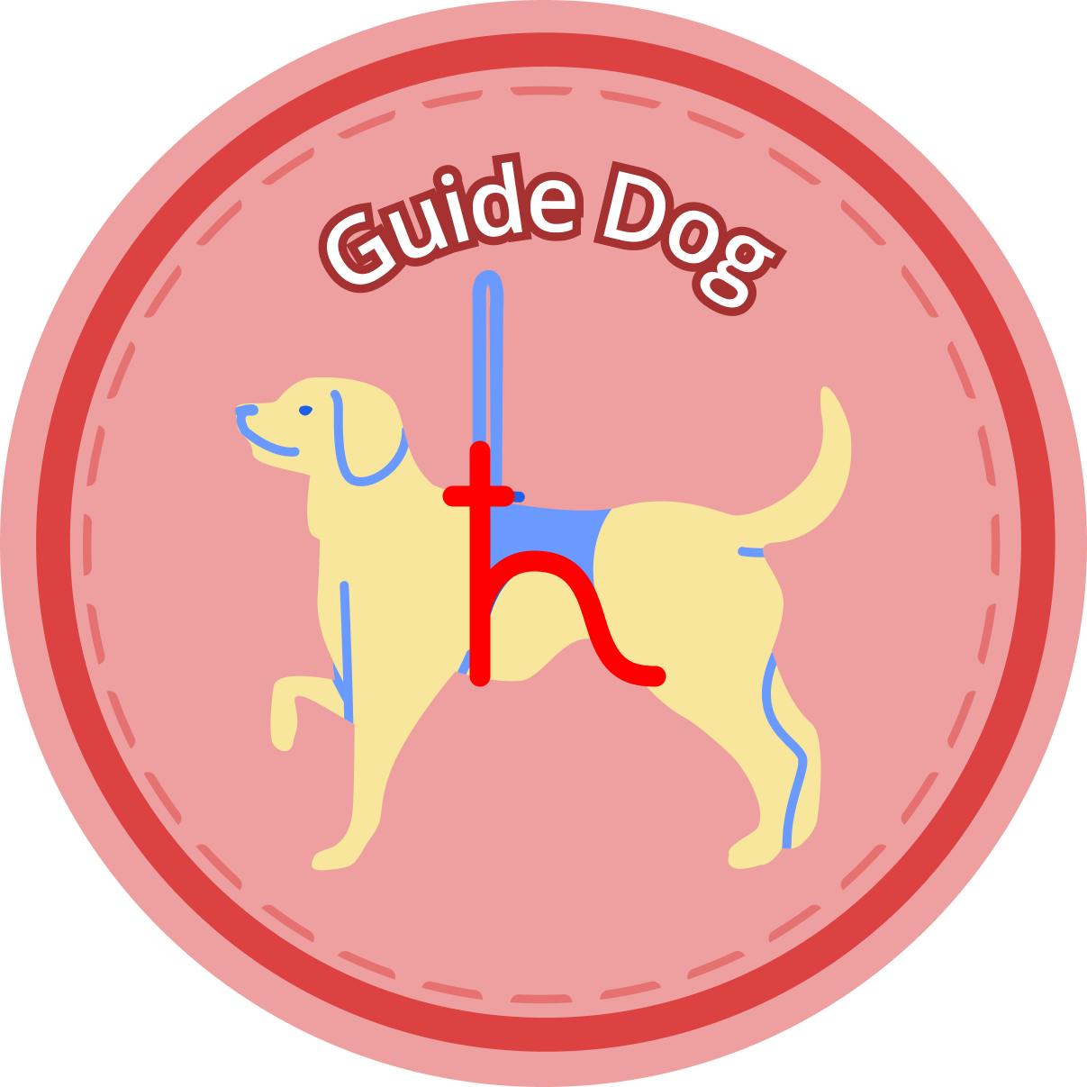
Hidden symbols…
Saturn’s symbol makes up the guide-dog’s harness

Slide 18

Hidden symbols…
And the SUN is shown in the wolf’s eye….

Slide 19
Our winners…

Slide 20
First Prize - £200
First prize goes to our first correct submission:
Made at 11.30 am on November 15th by………
Edie at Ely College CONGRATULATIONS!!!

Slide 21
Runners-Up
We had dozens and dozens of other correct submissions;
Each was entered into a random prize draw;
Some came from individuals, others from groups working together;

Slide 22
Runners-Up
The three winners of £100 each are:
Honey from Suthers School
David from Medina College
Layla from Sharnbrook School

Slide 23
One more thing
To claim your prizes, please ask your teacher to get in touch so we can send you your voucher!

Slide 24
Thank You!
Everyone who submitted a correct answer will also receive a rare MurrAye-Aye Lemur sticker during the next week.

Slide 25
Thank You!
WELL DONE to everyone who played, and KEEP COLLECTING your Tassimals!

